Slide 1


ROLE OF COMMUNITY NURSE IN DISASTER MANAGEMENT
DR. TITIH HURIAH

Slide 2

DISASTER IN HOLLY QUR'AN
QS 29 : 40
So each We seized for his sin; and among them were those upon whom We sent a storm of stones, and among them were those who were seized by the blast [from the sky], and among them were those whom We caused the earth to swallow, and among them were those whom We drowned. And Allah would not have wronged them, but it was they who were wronging themselves.
Maka masing-masing (mereka itu) Kami siksa disebabkan dosanya, maka di antara mereka ada yang Kami timpakan kepadanya hujan batu kerikil dan di antara mereka ada yang ditimpa suara keras yang mengguntur, dan di antara mereka ada yang Kami benamkan ke dalam bumi, dan di antara mereka ada yang Kami tenggelamkan, dan Allah sekali-kali tidak hendak menganiaya mereka, akan tetapi merekalah yang menganiaya diri mereka sendiri.

Slide 3
TAFSEER FOR QS 29 : 40
“and among them were those upon whom We sent a storm of stones” --> they are the people of Prophet Luth --> LGBT
“seized by the blast” --> they are Tsamud and the people in Madyan --> disbelieve of Allah and rejected the Messenger
“We caused the earth to swallow” --> it's about Qarun--> mischief-makers and disbeliever
“We drowned” --> the people of Nuh and Fir'aun --> disbelieve of Allah

Slide 4
it's time for QUIZ
What is the name of surah in Qur'an for those ayah:
A. Al Baqarah
B. Al Ikhlas
C. Al Ankabut
D. An Nisa
E. Al Maidah

Slide 5
INTRODUCTION
Indonesia, which is the world's largest island country and located between the Indian and the Pacific Ocean, regularly faces the hardship of many natural disasters, including earthquakes, tsunamis, and volcanic eruptions.
On average, at least one major natural disaster has occurred in Indonesia every month since the 2004 tsunami, including earthquakes, tsunamis, volcanic eruptions and events caused by climate change

Slide 6
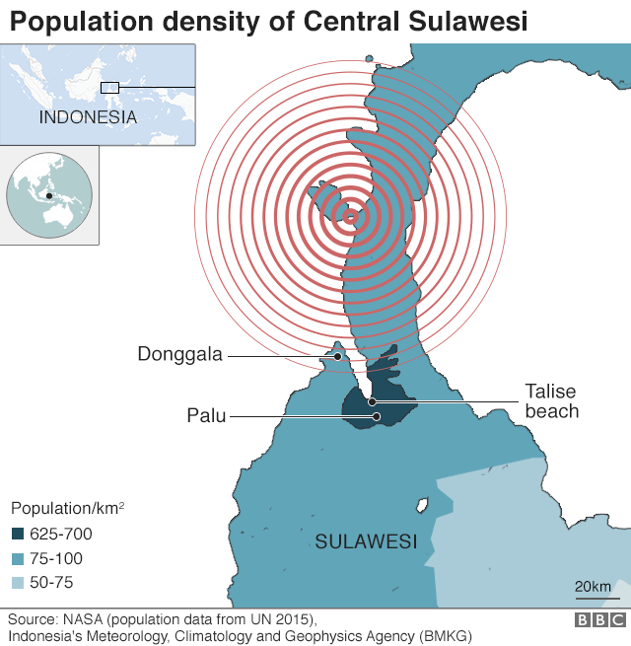
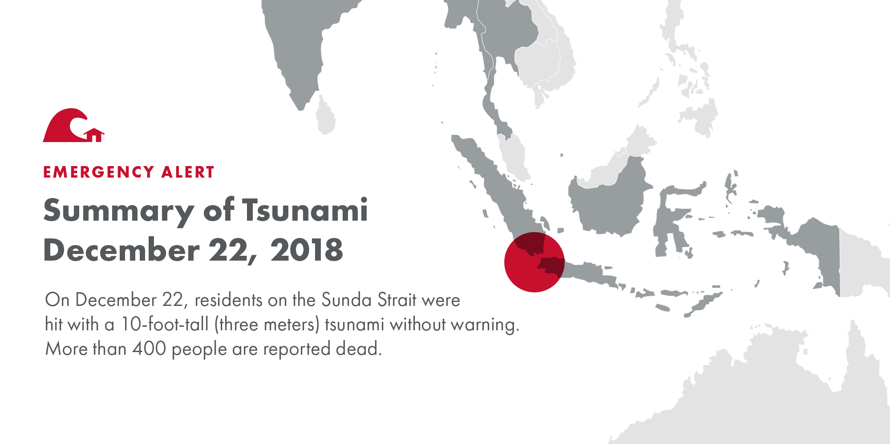
INTRODUCTION
Earthquake in Donggala, Palu

Slide 7
MEANING OF DISASTER
Disaster means a catastrophe, calamity on mishap, a grave occurrence which causes loss of life, human suffering, damage to and destruction of property degradation of environment which disrupts the normal functioning of societies, government comities and which adversely affects individual and families with severity and it is beyond the coping capacity of the community of the affected area.

Slide 8
DEFINITION
Any occurrence that causes damage, economic disruption, loss of human life and deterioation in health and the health services on a scale sufficient to warrant an extra ordinary response from outside the affected community or area.

Slide 9
it's time for QUIZ
There are 4 phases in the disaster management? can you mentioned it?

Slide 10
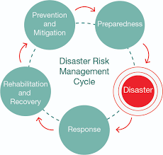
DISASTER MANAGEMENT
The effective organization direction and utilization of available counter-disaster resources
http://www.un-spider.org/risks-and-disasters

Slide 11
PHASES OF DISASTER MANAGEMENT
PREVENTIVE PHASE -> Mitigation, warning system
PERSONAL PREPAREDNESS -> Professional and community preparedness
RESPONSE PHASE
RECOVERY PHASE

Slide 12
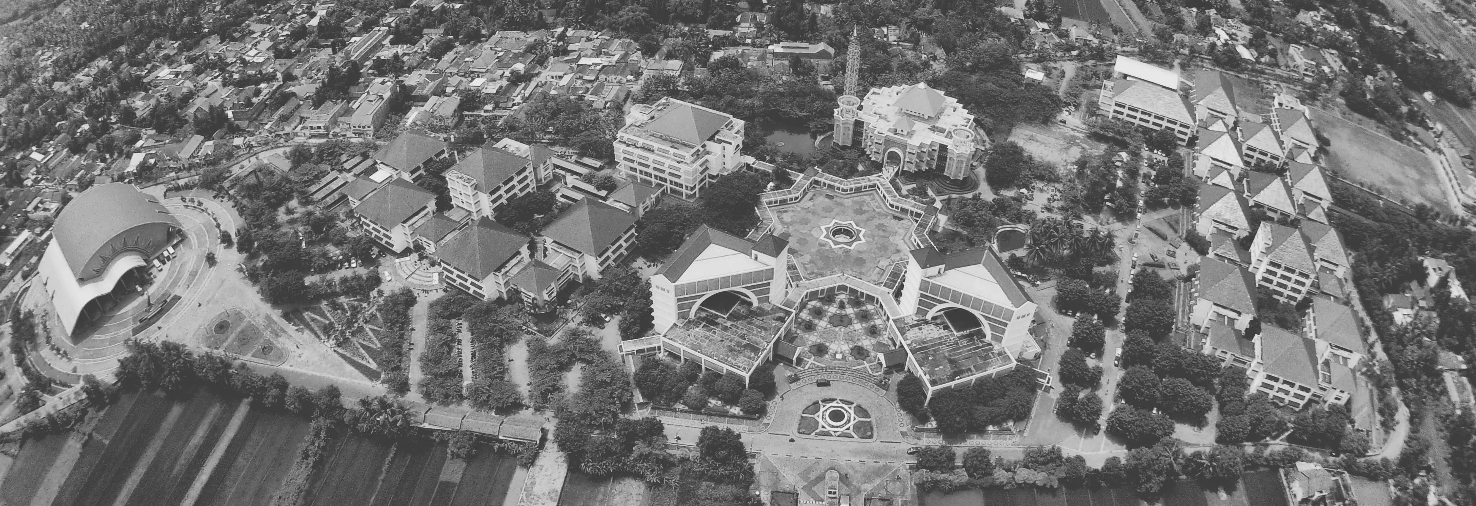
COMMUNITY NURSES ROLE IN DISASTER

Slide 13
ASSESSMENT
Assess the community (E.g. Local climate conductive for disaster)
Past history of disaster
Personal available in the community
local agencies
Health care facilities available

Slide 14
DEVELOP DISASTER PLAN
Aim : To provide prompt and effective medical care to the maximum possible in order to minimize morbidity and mortality.
Diagnose community disaster threats.
Determine the actual and potential disaster threats.
Community disaster planning

Slide 15
PREPARE THE STAFF AND INSTITUTIONAL RESOURCES
Objectives :
Prepare the staff and institutional resources.
Create a community awareness.

Slide 16
CONSTITUTION OF DISASTER MANAGEMENT
Plan for :
Constitution of disaster management committee
Disaster control room.
To refer the calamities to treat
Rapid response team
Information and communication.
Disaster beds
Logistic support system-equipment and supplies.
Training and drills.

Slide 17
ELEMENTS of DISASTER PLAN
Chain of authority
Lines of communication
Modes of transport
Mobilization
Warning
Equation
Rescue and recovery
Triage
Treatment
Support of victims and families
Care of dead bodies
Disaster worker rehabilitation.

Slide 18
ACTIVATION OF DISASTER MANAGEMENT PLANS
Develop a standard operating procedure
Reception area-Disaster content room.
Triage
Documentation at control room
Public relation
Essential services-eg.water and power and food
Crowd management/security arrangements.

Slide 19
ACTIVITIES NEEDED IN PLANNING
Identify local community communication system
Identify disaster personnel like private and professional voluntary etc.
Identify regional back up agencies and personnel
Identify specific responsibilities for various personnel involved in the disaster plan.
Set up an emergency medical system and chain of activation.
Identify location and accessibility of equipments and supplies.
Check proper functioning of emergency equipments.
Identify outdated supplies and replace.

Slide 20
IMPLEMENT DISASTER PLANS
Focus on primary prevention activities to prevent occurrence of man made disaster.
Practice community disaster plans with all personnal-eg. Triage, Supply of food ,water.
practice using equipment, obtaining and distributing supplies.

Slide 21
ROLE OF COMMUNITY NURSE IN DIFFERENT PHASES

Slide 22
it's time for QUIZ
What is the role of community nurse at recovery phase ?
A. Triaging the victims
B. Care for injured person
C. Creating awareness
D. Mass health education
E. Counseling

Slide 23
DISASTER PHASES
Passing message to the near by hospitals
Getting ready with emergency equipment
Discharging the patients
Creating awareness.

Slide 24
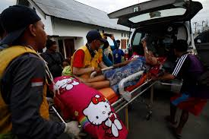
RESPONSE PHASE
Identify the population
Triaging the victim
Care for injured persons
Transporting patients
Arranging for physical facilities for the victim.
https://www.projecthope.org/tsunami-strikes-indonesia/10/2018/

Slide 25
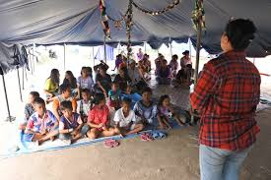
RECOVERY PHASE
Counseling
Continuing care
Vocational training
Behavior modification
Rehabilitation
https://www.globalgiving.org/projects/indonesia-earthquake-and-tsunami-relief-fund/reports/

Slide 26
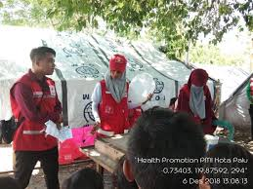
RISK REDUCTION PHASE
Awareness about disaster
Training to people
Mass health education
Education about warning signs of disaster
adore.ifrc.org

Slide 27
NURSES RESPONSIBILITY
PRE-PLANNING: developing a responsible plan
Storage of equipment and supplies
Follow the protocol of notification
Designation of an alternative reporting site for health care workers
Very familiar with the equipment and supplies to use
Much disaster drills
Use of personal protective devices
Knowledge on potential hazards at the disaster sites. E.g.: unstable building structure

Slide 28
COMMUNITY PREPAREDNESS
Education
First aid program
Making each home to store
Emergency telephone numbers
Battery operated radio
Flash light
First aid kit
Three day supply of water
Medical information &family physician detail
Persons to be notified in emergency

Slide 29
ROLE AND RESPONSIBILITIES OF THE DISASTER MANAGEMENT BOARD
Develop a National Disaster Action plan
Helping the ministries and agencies
Working with local authorities
Providing documentation and information services
Monitoring and referring the Govt.

Slide 30
During an Emergency
Ensure the effective communication and information
Activity and operate National emergency
Private secretarial service and expert advice to the National Disaster management Council and inter ministerial disaster management co-ordination committee.
Provide information to and liase with the economic relations divisions and the ministry of information.

Slide 31
During Post Disaster Recovery
Co-operate with the planning commission and line agencies on reconstruction requirements
Ensure the risk reduction measures.
Under take final evaluation.

Slide 32
CONCLUSION
Community health nurses are an integral part of disaster planning and implementation efforts. They are involved as planners, educators, direct care givers and assessment supervisors.
They serve as a community survey assessment or triage officers after the disaster has occurred. Hence participate actively in disaster management as a community health nurse and protect the health of the community before, during and after disaster.

Slide 33


