Slide 1
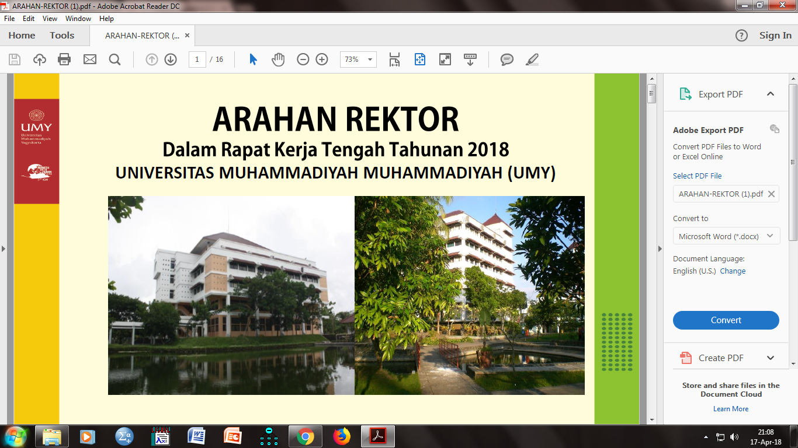
RE-ORIENTASI STRATEGI PENGEMBANGAN SDM ERA DIGITAL PADA REVOLUSI INDUSTRI 4.0

Slide 2
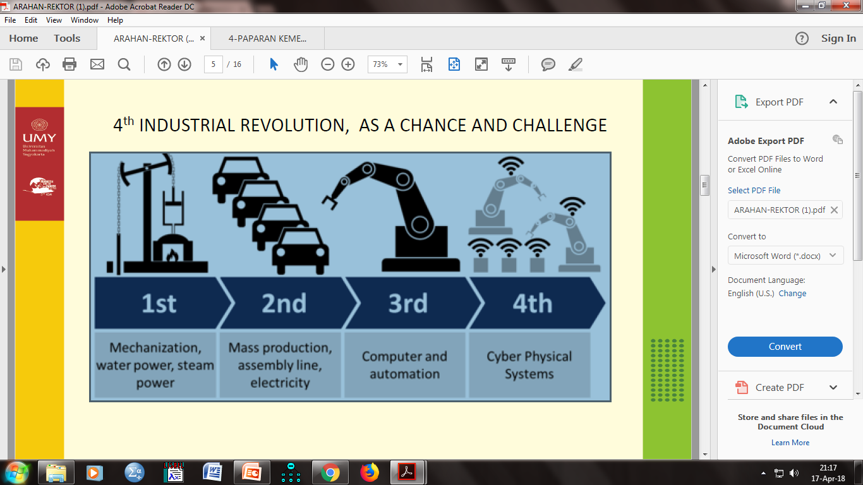

Slide 3
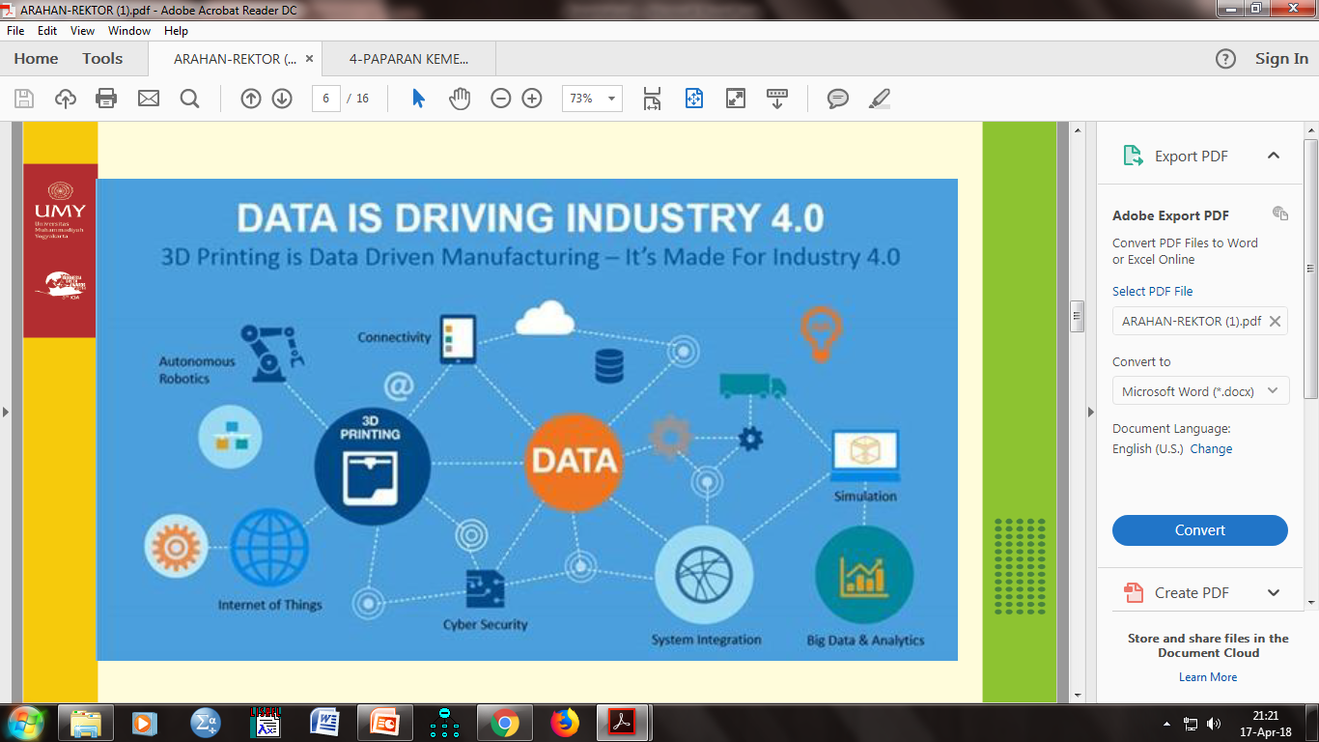

Slide 4
FINANCIAL CAPITALISM
Keuntungan bukan dari selisih cost vs income, tapi dari menaikkan harga dari model derivasi, hedge funds, arbritase, pasar komoditas (future market) dan sejenisnya.
Bauman (1984, p. 1998, p. 44) : Illusion of wealth, Roberts & Armitage (2006) : Speed Transaction, Montgomerie and Williams, 2009) : disembedded from real economy.
shareholder value [SV] is more important than social order or social justice in terms of availability of jobs and the wages and conditions of those jobs.

Slide 5
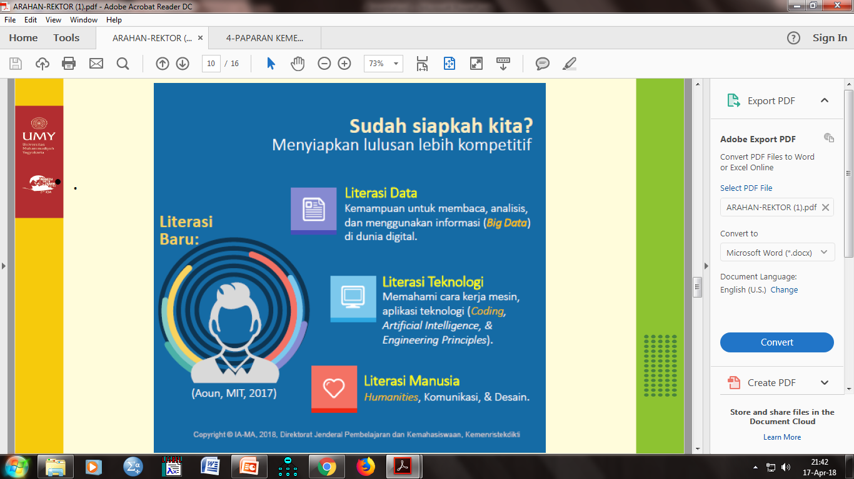
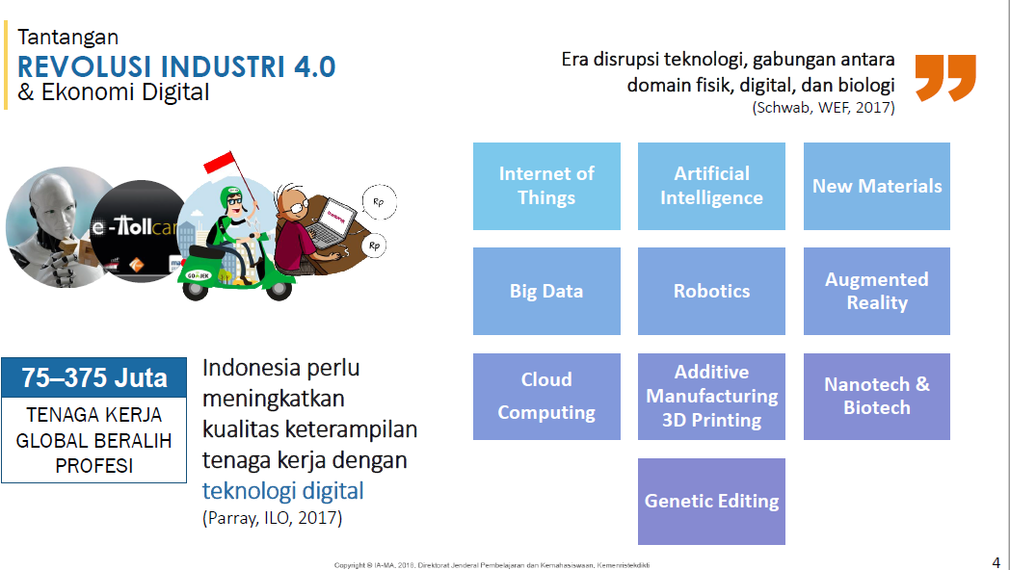

Slide 6
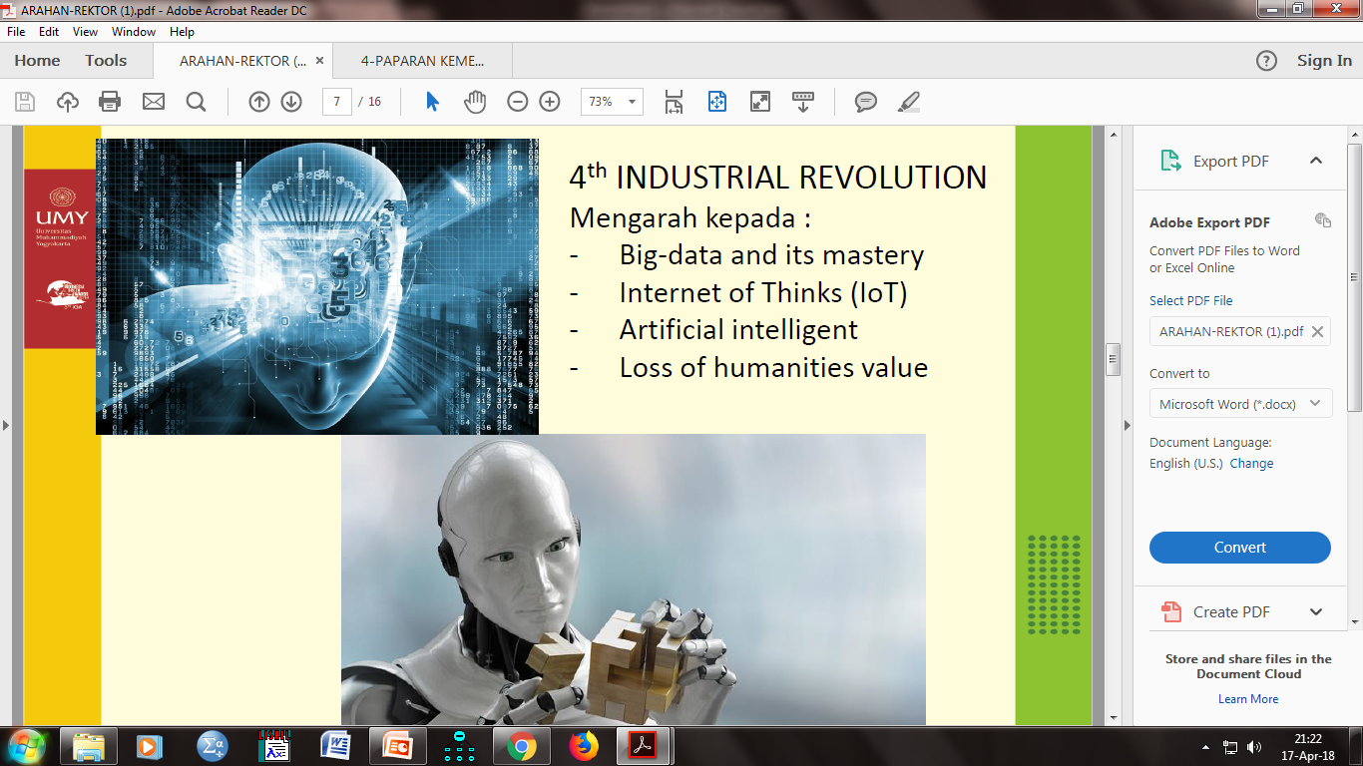

Slide 7
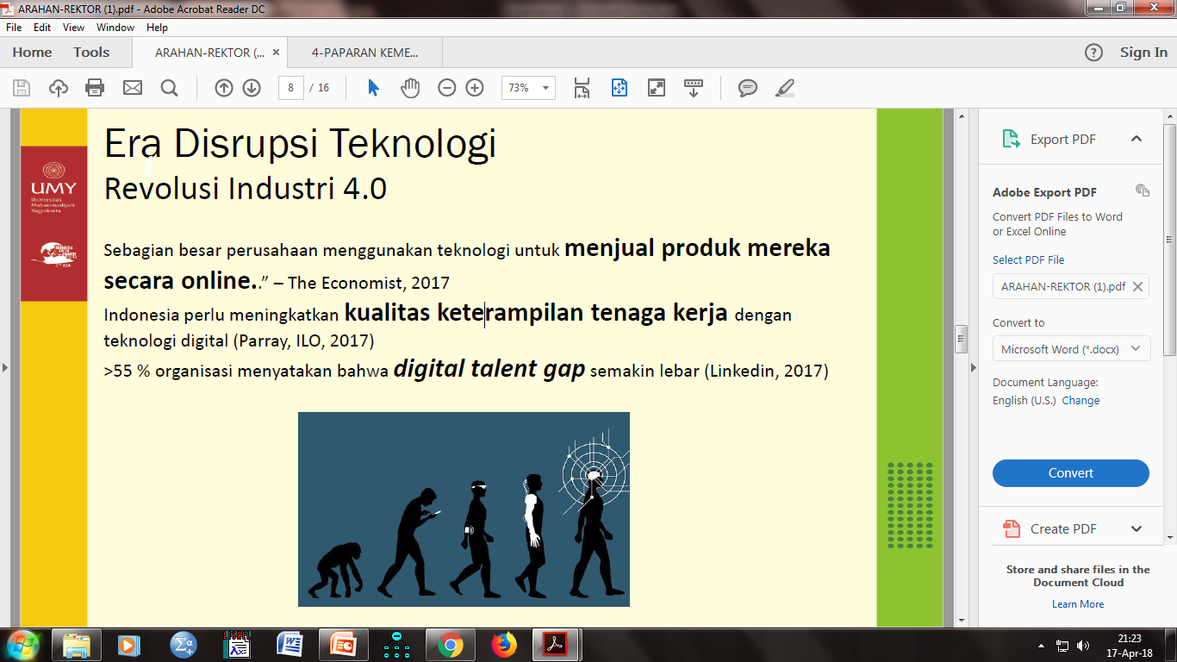

Slide 8
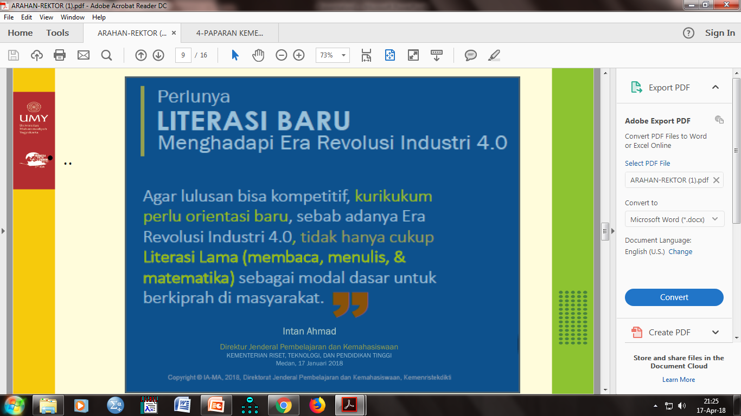

Slide 9


Slide 10
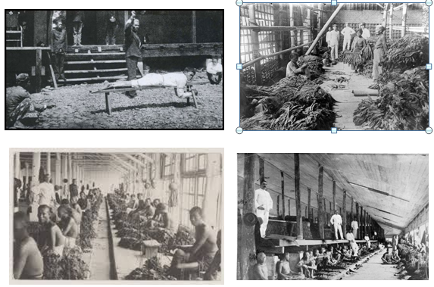
HRM TRADITIONAL

Slide 11
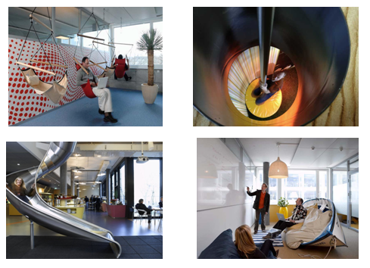
HRM STRATEGIC

Slide 12
HRM TRADISIONAL VS
HRM STRATEGIS
No | Indikator | Traditional HR | Strategic HR
1 | Responsibility for HR | Staff specialist | Line managers
2 | Focus | Employee relations | Partnership with internal and external costumers
3 | Role of HR | Transactional change follower and respondent | Transactional change leader and initiator
4 | Initiatives | Slow, reacted, fragmneted | Fast, proactive, integrative
5 | Time horizon | Short term | Short, medium, long (as necessary)
6 | Control | Bearucratics-roles, policies, procedures | Organics, flexible, whatever is necessary to succed
7 | Job design | Tight devision of labour, independence, scpecializations, | Broad, flexible, cross-training, teams
8 | Key investments | Capital, products | People, knowledge
9 | Accountability | Cost center | Investment center

Slide 13
POTENSI OTOMATISASI LAPANGAN PEKERJAAN (MCKINSEY, 2017)

Slide 14
PENGARUH REVEOLUSI INDUSTRI 4.0
BERDASARKAN DISTRIBUSI NEGARA
(MCKINSEY, 2017)

Slide 15
PENGARUH REVEOLUSI INDUSTRI 4.0
BERDASARKAN DISTRIBUSI NEGARA
(MCKINSEY, 2017)

Slide 16
Potential For Automation Across Sectors (Mckinsey, 2017)

Slide 17
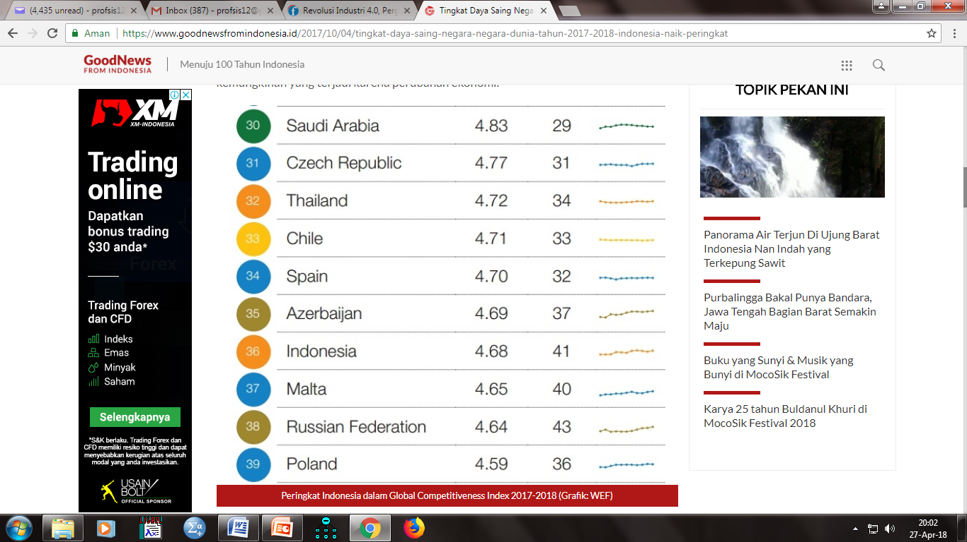
POSISI DUNIA GCI INDONESIA

Slide 18
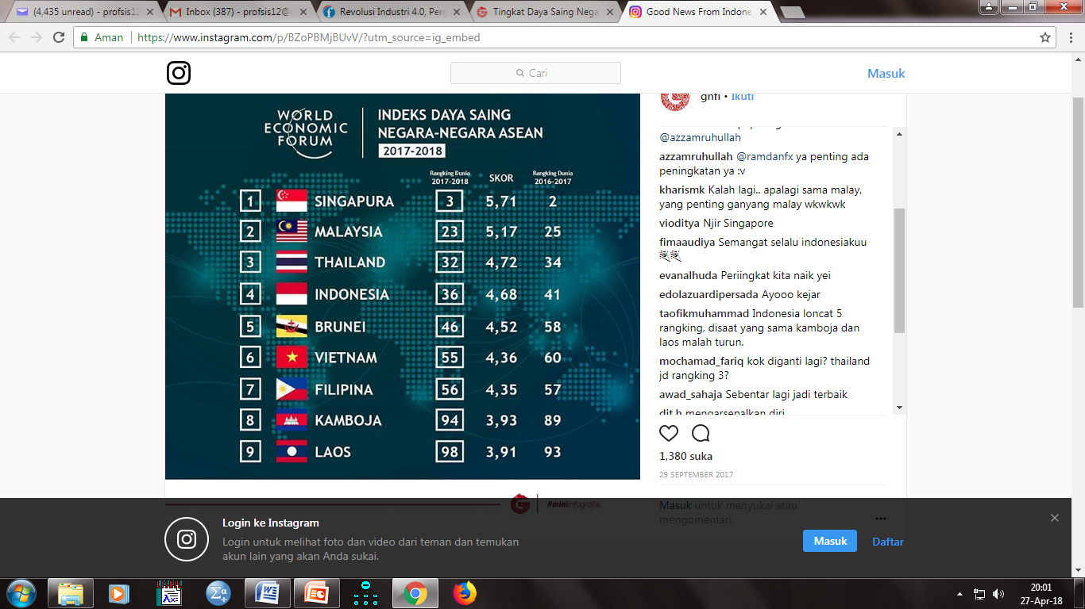
POSISI DAYA SAING ASEAN

Slide 19
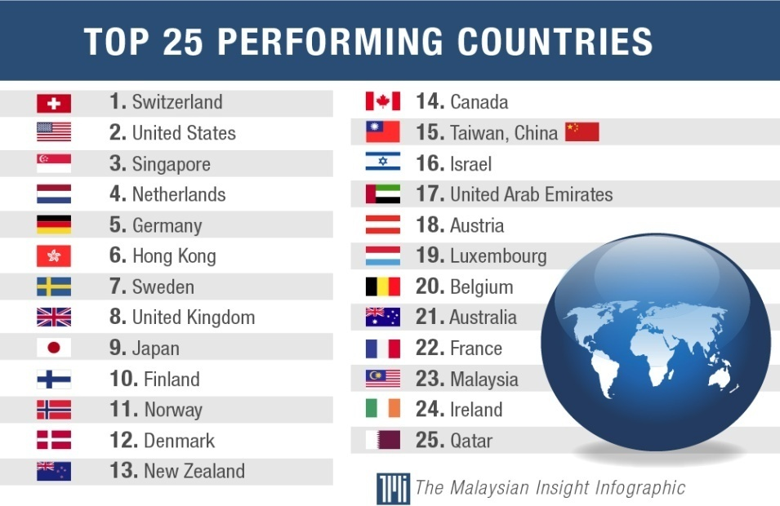
TOP 25 GCI DUNIA

Slide 20
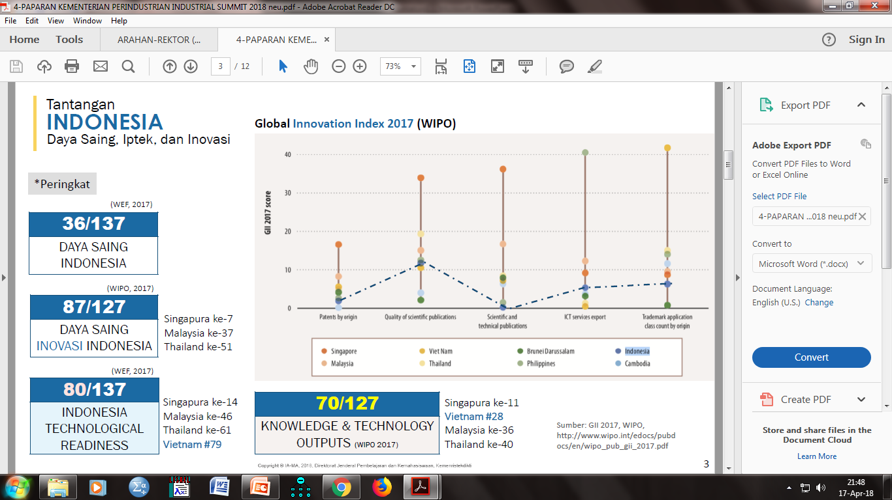

Slide 21
RE-ORIENTASI HRM
Kualitas, yaitu upaya menghasilkan SDM yang berkualitas agar sesuai dengan kebutuhan pasar kerja yang berbasis teknologi digital.
Kuantitas, yaitu menghasilkan jumlah sdm yang berkualitas, kompeten dan sesuai kebutuhan industri.
Distribusi SDM berkualitas yang masih belum merata.

Slide 22
RE-ORIENTASI HRM
Literasi data, yaitu kemampuan membaca, menganalisis dan memanfaatkan informasi big data dalam dunia digital,
Literasi teknologi, yaitu memahami cara kerja mesin, aplikasi teknologi (coding, artificial intelligence dan engineering principles, dan
iterasi manusia, humanities, komunikasi dan desain.

Slide 23
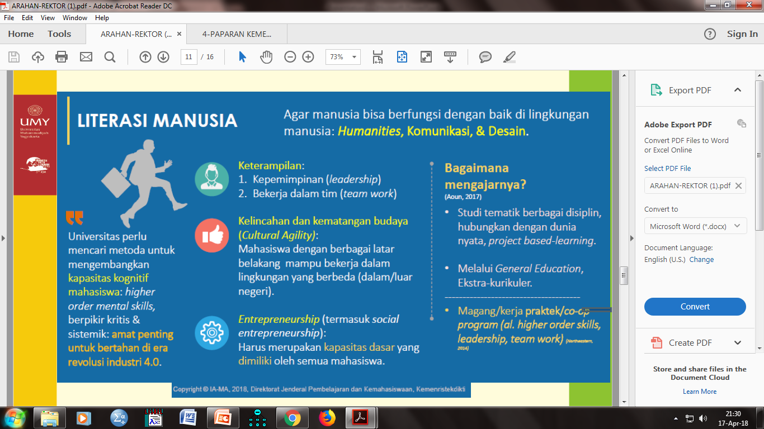

Slide 24
RE-ORIENTASI HRM
Mount et.al. (1994) : extravenous, agreeableness, conscientiousness, emotional stability dan openness to experience.
Kecerdasan emosional (Golemen, 1977), spiritual (Agustian, 2000) : kesadaran diri (self-awareness), manajemen perasaan (emotional management), motivasi diri (self-motivation), perasaan iba hati (empathy), mengelola hubungan baik (managing relationship), keterampilan komunikasi (communication skills) dan gaya pribadi (personal style).

Slide 25
RE-ORIENTASI HRM
Tacit dan explicit knowledge (Nonaka dan Takeuchi, 1995) dan Polanyi (1966).
Explixit knowledge : Pengetahuan yang bersifat formal dan sistemik yang dapat diekspresikan dengan kata-kata dan angka.
Tacit knowledge : Pengetahuan yang bersifat istimewa, sangat pribadi dan sulit untuk diformalkan dan dikomunukasikan disebut

Slide 26
RE-ORIENTASI ORGANISASI
Resource Based View (RBV), Ketchen et.al. (2009) :
Tangible resource : financial, physical, technological and organizational.
Intangible resource : human, inovation, reativity, and reputation
Organizational capabilities : outstanding customer service, excellent product development capabilities, innovation of product and services and ability to hire, motivate and retain human capital.

Slide 27

THE END
THANK YOU

